Slide 1


Department of Electronics and Communication Engineering
MINOR PROJECT 1
To Develop a Device Driver for UART using LPC1768
SL.NO. | NAME | USN | ROLL. NO
01 | ALEENA MULA | 02FE21BEC006 | 05
02 | BASAVESH PATIL | 02FE21BEC018 | 15
03 | HARSH PATIL | 02FE21BEC035 | 32
04 | PRATIK PATIL | 02FE21BEC063 | 58
Under the Guidance of
Prof. Ashwini Desai

Slide 2
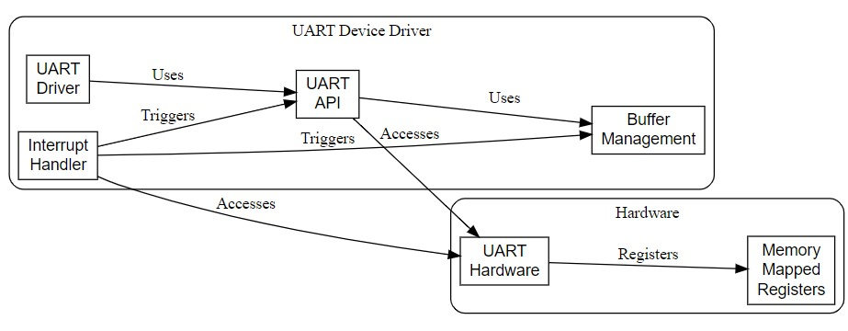
Detailed Block Diagram

Slide 3
DETAILS
UART API
Configure Baud rate
Configure Data Length
Configure Parity
Configure Stop Bits
Transmission of data
Receive data
UART REGISTERS
THRE (for transmitting the data)
RBR (for receiving data)
LCR (to configure API)
LSR (to check for errors)

Slide 4
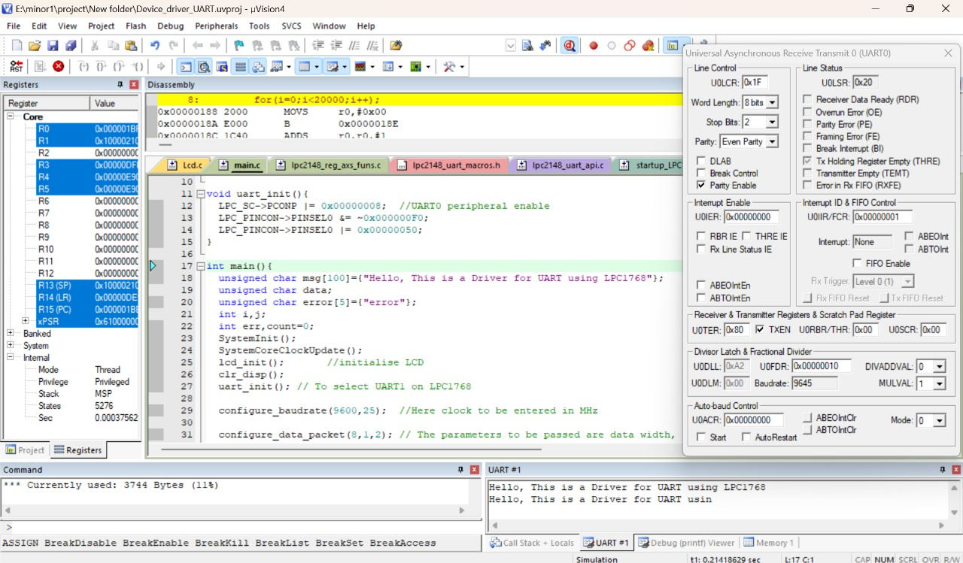
SIMULATION

Slide 5
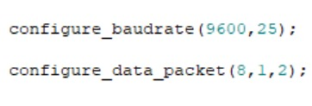
PLAN AND NEED FOR OPTIMIZATION
BEFORE OPTIMIZATION
Configuration of the functions is difficult here, for changing a bit we have to refer to the datasheet of the respective microcontroller.
Applicable to only specific microcontroller.
High chances of error.
U0LCR = 0x83;
U0DLL = 0x61;
U0LCR = 0x03;
U0IER = 0x01;
AFTER OPTIMIZATION
Configuration of the functions is lot more easier and user friendly.
By slight change can be applicable to many microcontroller.
Minimal to No chances of error.

Slide 6
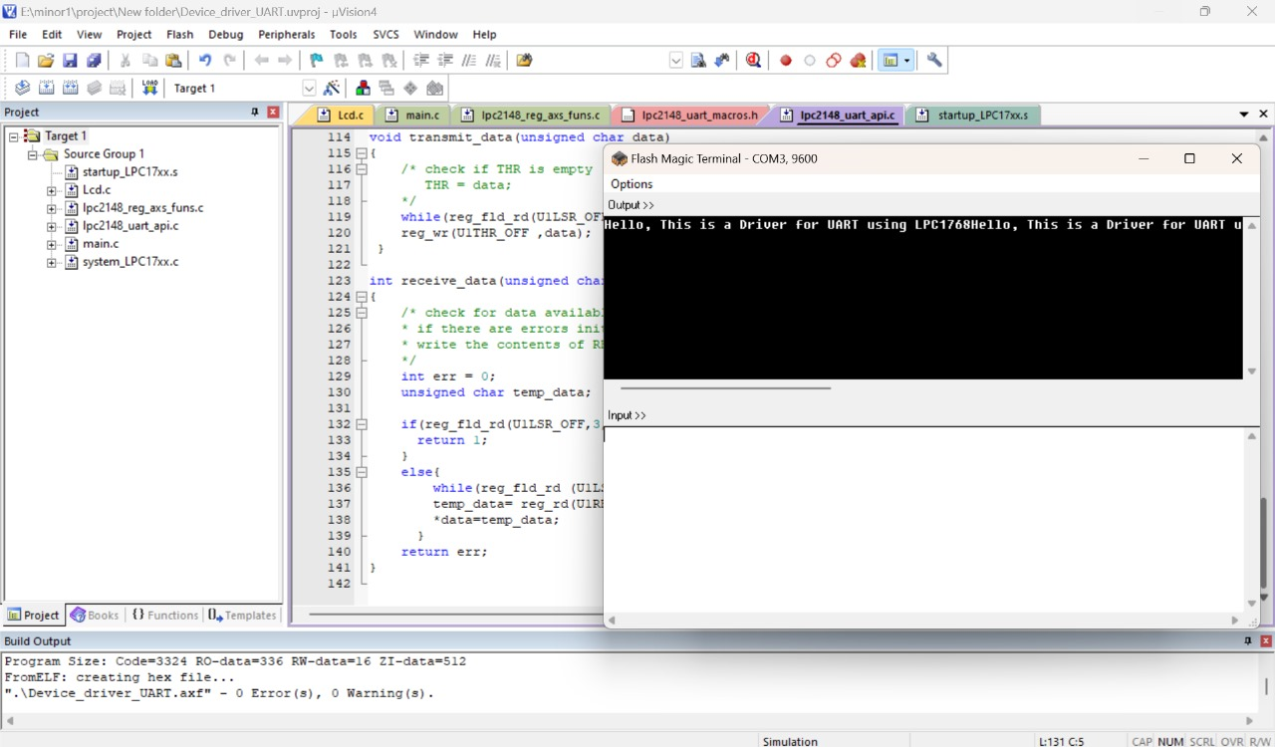
IMPLEMENTATION

Slide 7
THANK YOU

